Slide 1

Problem Statement 5
Crypto Currency Price Prediction Machine Learning Model
Team Members –
Ayush Bansal
Anusha Yadav
Sakshi Kukkal
BSN Abhiram

Slide 2
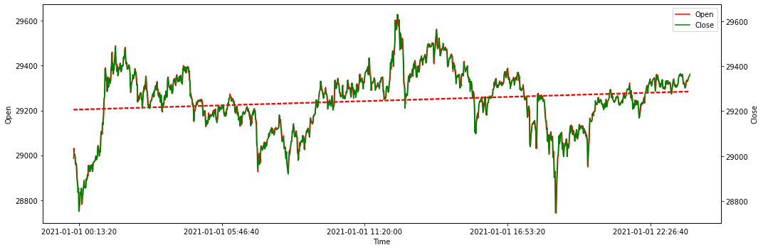
Short term analysis based on past data and trends
Plot on Bitcoin’s Opening and Close Price vs Time on 1st January 2021
This tells us the highest and lowest value the currency reached on the day and the overall result (if the value of currency increased, decreased or remained same) in short term. Studying and predicting short term fluctuations are model’s ultimate goal, so that the trader can decide whether to buy, sell or hold his currency.

Slide 3
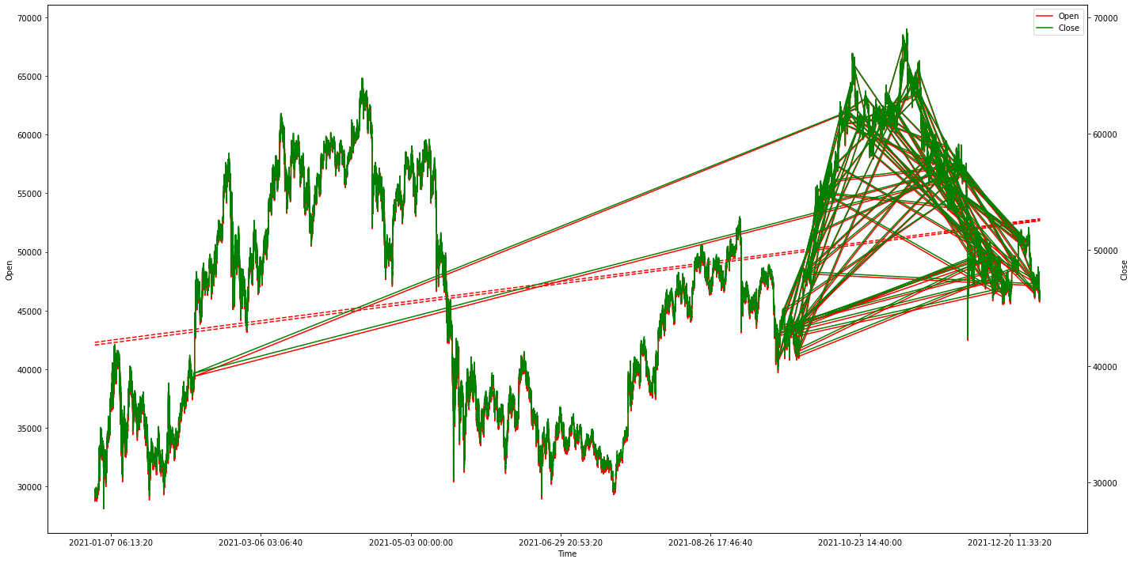
Long term analysis based on past data and trends
Plot on Bitcoin’s Opening and Close Price vs Time of year 2021
This is the long term plot which tells us the overall growth of currency. There are fluctuations and dips, but in the end, the overall prices for the coin have risen from year 2020, and thus the trend line (red dotted line) has a positive slope.

Slide 4





Model analysis
The machine learning model is based on python and will use previous data to predict cryptocurrency’s ‘open’, ‘close’, ‘high’, ‘low’ and ‘volume’ parameters on a given time.
The model will use ‘Exponential smoothing’ prediction model of economic statistics to predict these values.
On the basis of predicted values, the model will suggest the best move for the user.
The predicted values can further be scored on the model using data science algorithms like ’Random Forest’ or using transfer learning model like ‘LSTM’ from Tensorflow Hub.

Slide 5
Model analysis – Improvement Scope
Cryptocurrency is found to be mostly affected by Analytical, Social and Political factors.
Analytical Factor takes in account number of holders and percentage of currency each of them holds. This will also include effect of improved/deteriorated technology on the currency.
Social Factor takes in account the popularity of the currency and those who own the currency (Owners not buyers).
Political Factor takes in account the news and the government decisions of a country which may affect the currency prices.
These factors can be graded on following scale –
-1 for not favourable
0 for neutral
1 for favourable
These factors can be accounted for in short term and can affect the quantities to be predicted.
On the other hand, in long term, these factors won’t make much difference unless the currency is either banned or demolished.

Slide 6


GUI and API
The model will be raw python codes in Jupyter Notebook. To help users access and understand it, a GUI will be developed using Django. This will be a user friendly web application interface which will give the beginners an on-boarding for Cryptocurrency and Block-chain, so that they can understand what they are investing in. Further, users will be shown the graphs and predicted values based on previous data and will be suggested best actions in both short and long term.
API facility will also be provided so that developers can easily integrate our model in their projects use the predicted data as per their need.
Upon the success of the project, the model can also be launched in form of a mobile application.

Slide 7

Future possibility
Every cryptocurrency provides it’s white paper, which essentially determines the future of the currency. It helps users know if the currency is willing to work on it’s improvement or if it is planning to leave the market, which will result into great loss for many.
The model on further improvement may check for the whitepaper and add another factor which can be called as ‘Whitepaper factor’ which can again be graded on the scale of -1 to 1.
This is a future possibility as currently there is no dataset on the whitepaper of different currencies. Whitepapers can be fetched from currency’s official website.
A portal to buy and sell the currency can also be provided so that users can study and invest in the currency at same time and place.

